Slide 1
Big Data Representativeness and Expansion Considerations
Steven Trevino, RSG
November 16, 2017

Slide 2








Recap of Last Year

Slide 3
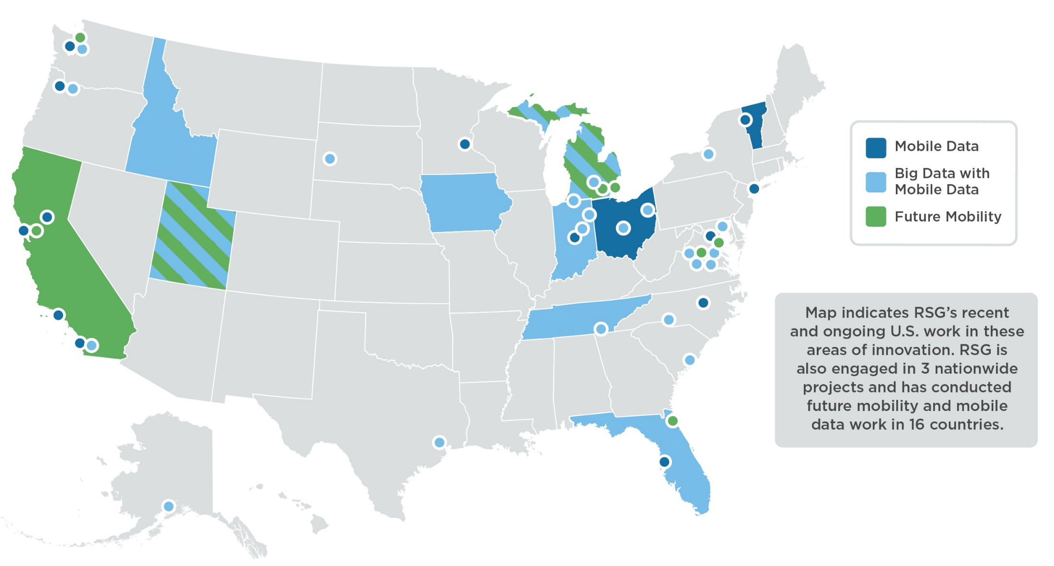
RSG Experience

Slide 4
The Power of Big Data

Slide 5
The Power of Big Data
  TN STATEWIDE DATA
Combined household survey
  NHTS + 4 MPOs
  10,344 households
AirSage and ATRI datasets
  Trip Table (OD pairs)
  CHATTANOOGA DATA
2010 household survey
  1,502 households
AirSage and ATRI datasets
  Trip Table (OD pairs)
Total | 12,744,900
Survey | 39,782 | 0.3%
Airsage | 3,355,539 | 26.3%
Total | 529,984
Survey | 8,350 | 2.0%
Airsage | 182,742 | 34.5%

Slide 6
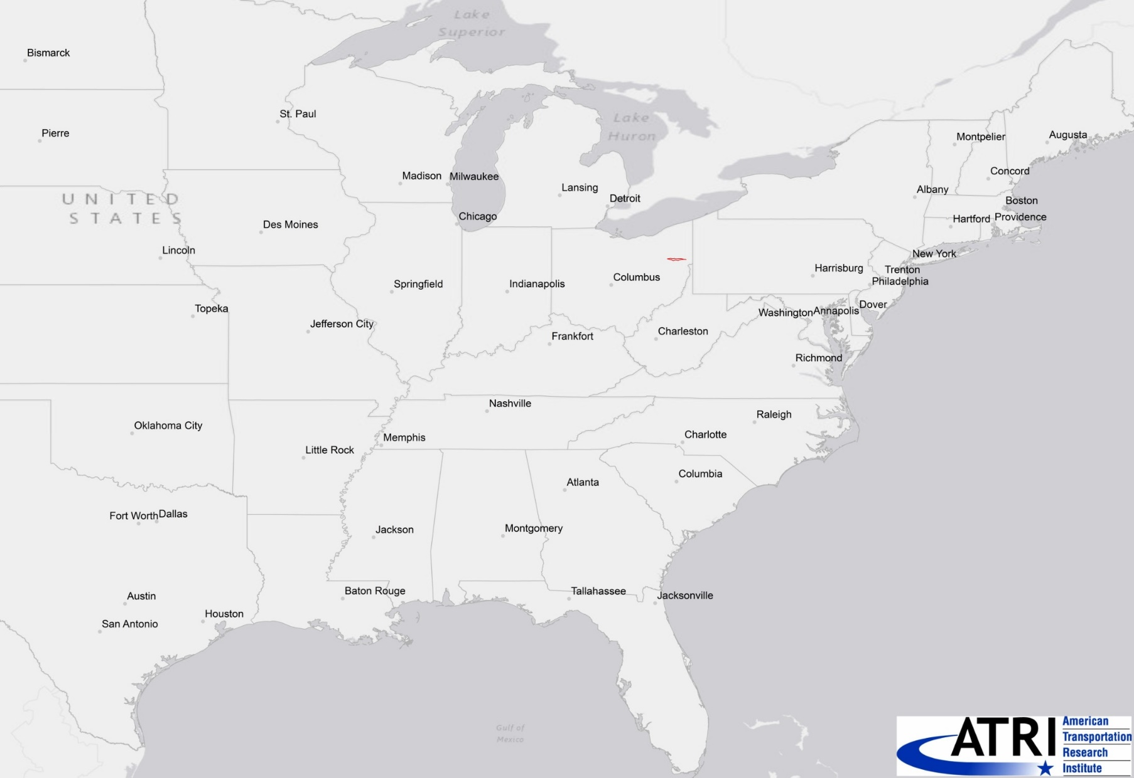
US 30 Study Area

Slide 7
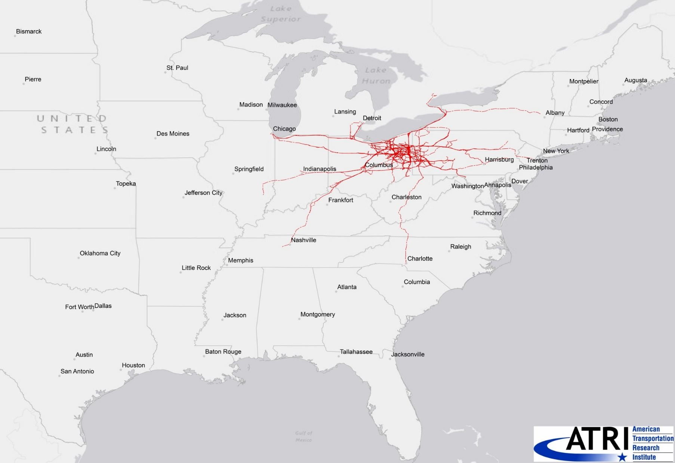
Trucks using the US 30 corridor – after 1 Day

Slide 8
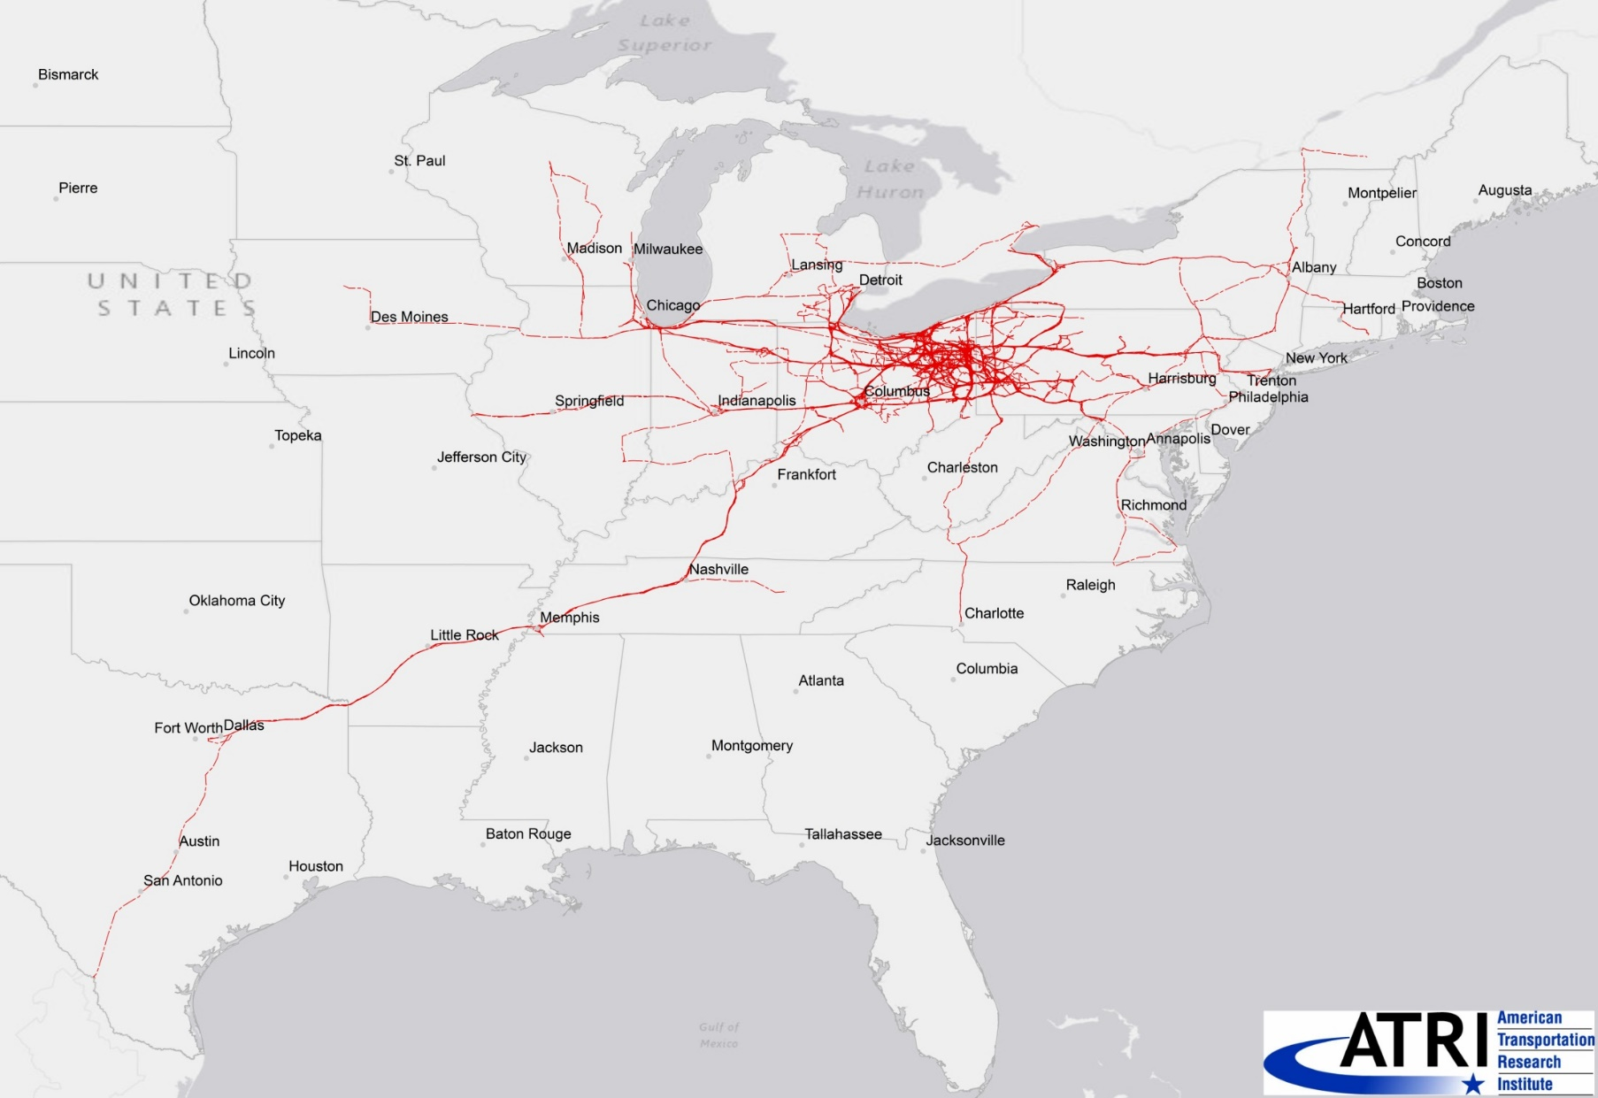
Trucks using the US 30 corridor – after 3 Days

Slide 9
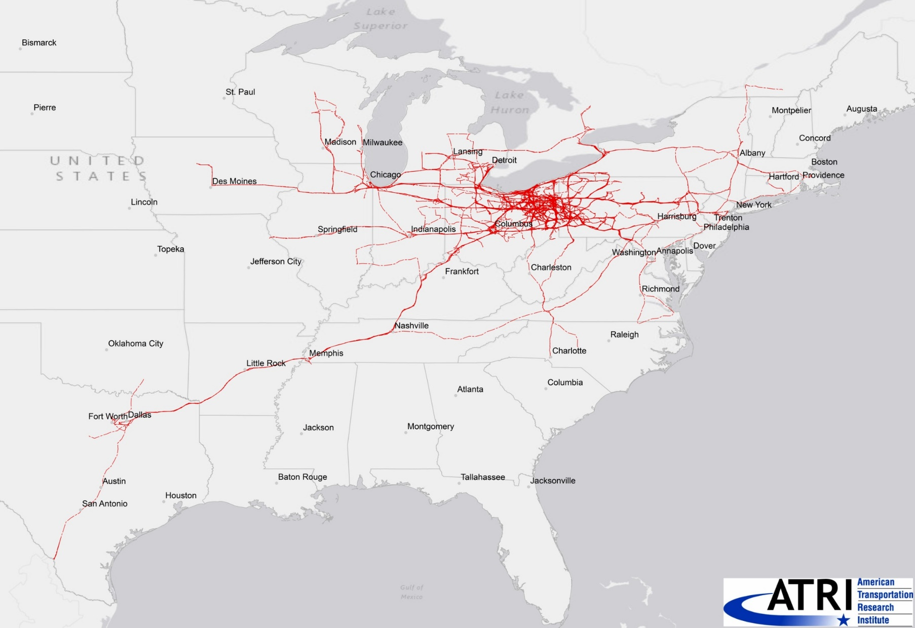
Trucks using the US 30 corridor – after 5 Days

Slide 10


Can you recognize the pattern based on <2%?

Slide 11


How about based on >25%?

Slide 12
Big Data allows us to see the Big Picture

Slide 13

But what about this 25%?

Slide 14
The Limitations of Big Data

Slide 15
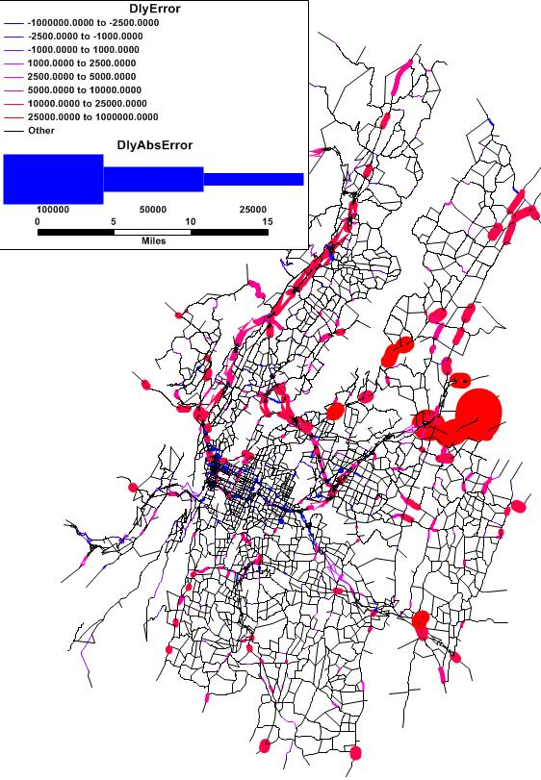
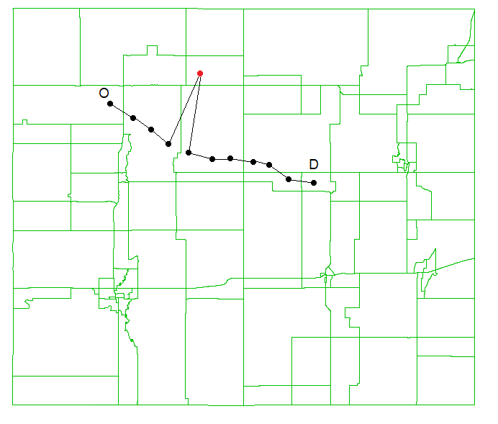
Cleaning Required
  Filtering / cleaning
    Needs vary by data source – but all need it
    GPS jumps/blips and equivalent
    Missing data

Slide 16
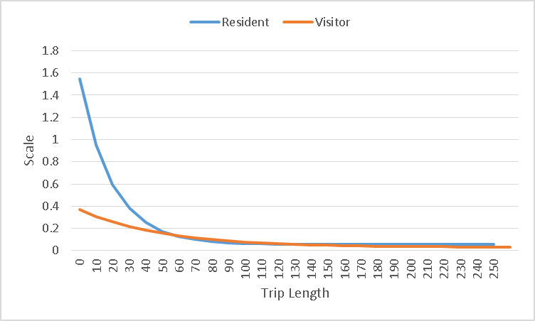
Not Representative
  Big Sample NOT Random Sample
    Locational biases, holes
    Trip length / duration biases
    Not corrected by penetration-based expansion
100 mi trip is 12 times as likely to be detected as a 10 mi trip

Slide 17
Model Results with Big Data

Slide 18
To/From TN Trip Distribution
  DISTRICT-TO-DISTRICT COMPARISON
  Generally good agreement
  District level origins & destinations all within 10%, most within 3%
    Smoky Mtns not attracting enough to/from Knoxville
  District level ODs all within 4% except within Nashville - Northcentral
  Relative Percentage Difference (Model Version 3 vs AirSage) I-E & E-I Trips

Slide 19
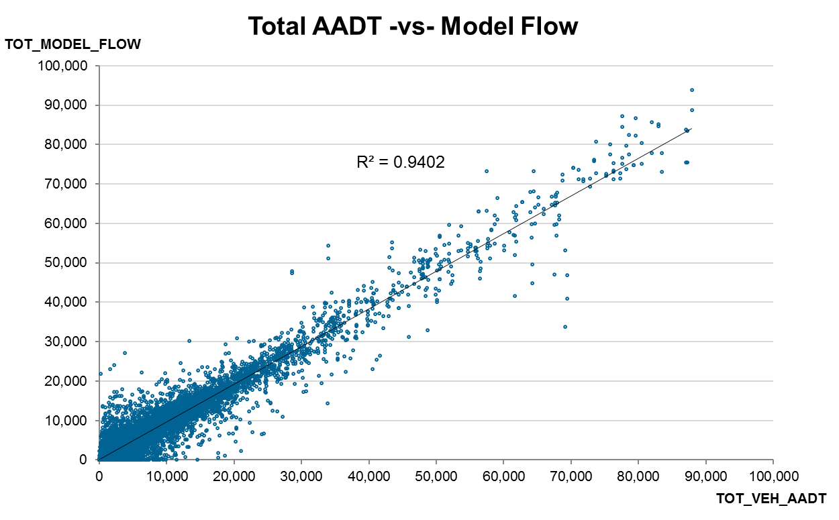
Assignment Validation
Volume Range | RMSE | TDOT TARGET
< 5,000 | 102.1% | 101.4%
5,000 to 10,000 | 35.6% | 56.3%
10,000 to 20,000 | 22.0% | 51.4%
20,000 to 30,000 | 16.4% | 35.7%
30,000 to 40,000 | 14.8% | 32.0%
> 40,000 | 11.1% | 12.2%
All | 36.6% | 60.0%
  Great fit - One of best statewide models in the country
  Used ODME – with constraints, (some other statewide models do to)

Slide 20
Total Daysim Trip Table vs. AirSage
  Daysim vs. AirSage
    Very good agreement –
    All cells within +/- 1%
    All residence/work Super Districts within +/-2.5%
    10.5% RMSE

Slide 21
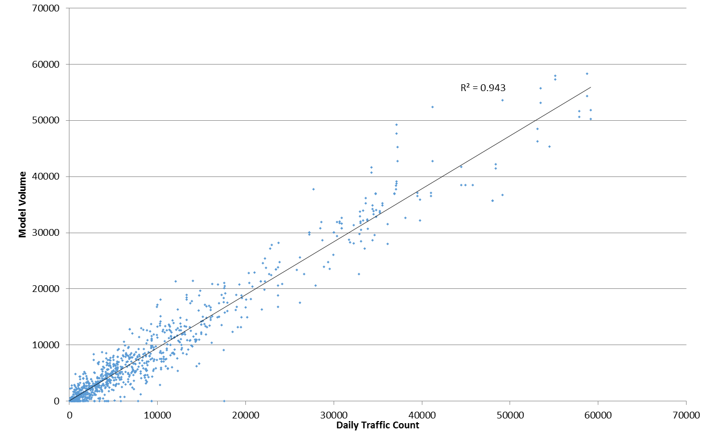
Assignment Validation
Volume Range | RMSE | TDOT Maximum
< 5,000 | 62.1% | 100%
5,000 to 10,000 | 37.9% | 45%
10,000 to 15,000 | 28.0% | 35%
15,000 to 20,000 | 22.7% | 30%
20,000 to 30,000 | 15.7% | 27%
30,000 to 50,000 | 14.1% | 25%
50,000 to 60,000 | 9.9% | 20%
All | 29.0% | 45%
  Great fit!
    Better than old model
    Far exceeds TDOT standards
    No ODME,
    only
    screenline
    factoring

Slide 22
Data Validation and Cleaning

Slide 23
Tips for Clean Streetlight Data Queries
  Minimize data cleaning on the front end
    For GPS external station data queries – use two directional pass-through zones per external station
    Separate queries of EE and EI/IE will result in double-counting
    Be careful/intentional about the treatment of intermediate stops on EE trips / whether you want one EE trip or an EI and IE
    For LBS external catchment/buffer zones, use length based on corridor speeds (further for interstates)
    For LBS queries around water, buffer out some distance (e.g., 50 or 100 m) into the water – but consider leaving gaps between zones in wide rivers

Slide 24
Trip Rate Comparisons
  Start by examining the marginals of the OD matrix and comparing them to zonal SE data
    Examining trip rates can identify various data problems
      Coverage holes (more of an issue for cellular data, but can also arise from line-of-sight issues such as urban canyons for GPS data)
      Sampling issues (generally more of an issue for commercial vehicle data because of the lumpiness of the sample)
      SE data issues (Oh, right that place did close! Oh, yeah, there’s a new subdivision there!)
    Internal validity checks examine outliers within the dataset (e.g., zones with trip rates < or > 2 SD from the mean)
    Comparisons against modeled or quick-response P+As often is even more helpful

Slide 25
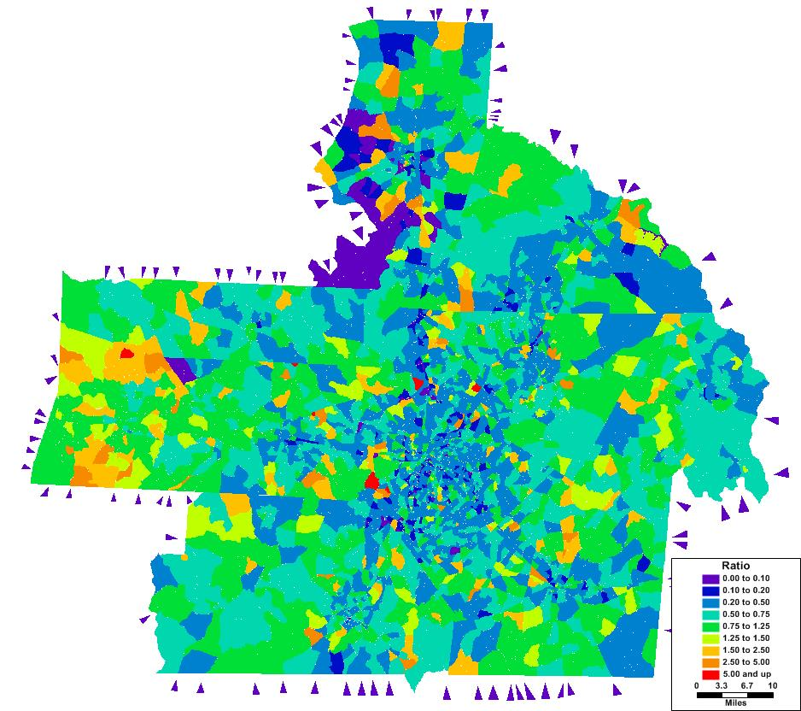
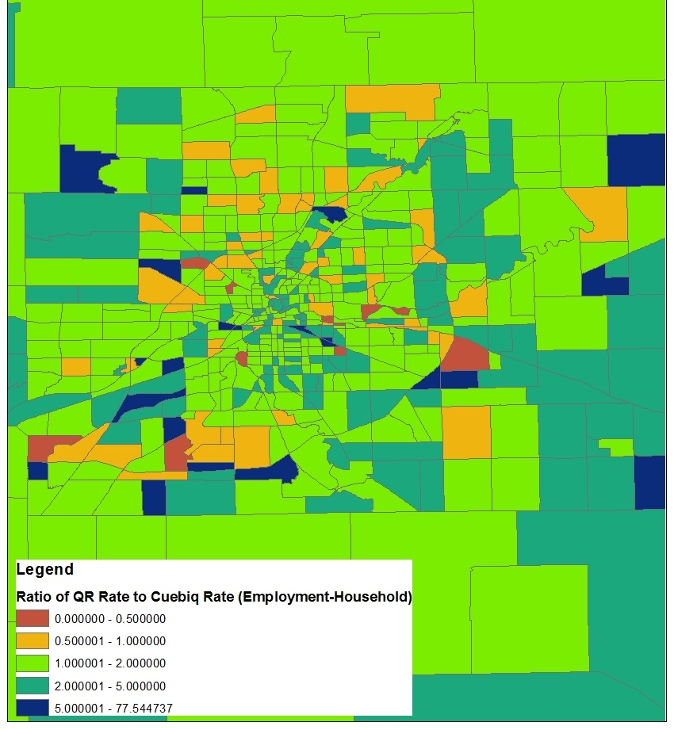
Trip Rate Comparisons
  Area type biases can be complicated and result from a combination of observation bias and trip/activity duration biases
Notes:
Apologize that color ramps are inconsistent / reversed

Slide 26
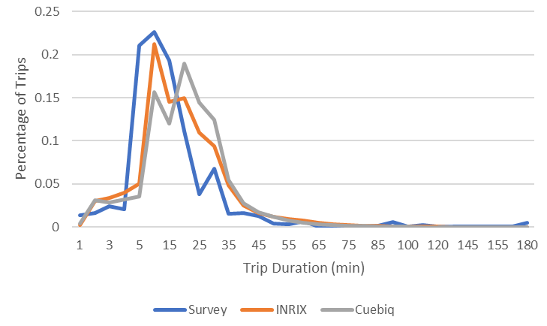
Trip Length Comparisons
  Not always the most important or useful, but generally good practice to compare trip lengths where possible, too
Notes:
Note the oddness of the scale

Slide 27
Data Expansion

Slide 28
Overview of Methods
  Aware of 8 methods currently in use, and new methods being actively being researched
  Most robust expansion schemes combine several methods
    SE data based and simple scaling to counts are among most commonly used and most commonly used alone
    But these cannot correct for trip/activity duration biases
  Group methods first by type of control data used
    Then subdivide count-based methods based on single/multiple factors, network based / not, parametric / non-parametric

Slide 29
Taxonomy of Expansion Methods
SE Data Methods
  Market Penetration (Residence-based)
  Trip Generation-Based
Traffic Count Methods
  Simple Scaling to Counts
  Multi-factor Scaling
    Non-Assignment-Based
      Iterative Proportional Fitting to Counts (Frataring)
      Iterative Screenline Fitting / Matrix Partitioning
    Network Assignment-Based
      Nonparametric (ODME)
        Direct ODME
        Indirect ODME
      Parametric Scaling to Counts
Trace Data Methods

Slide 30
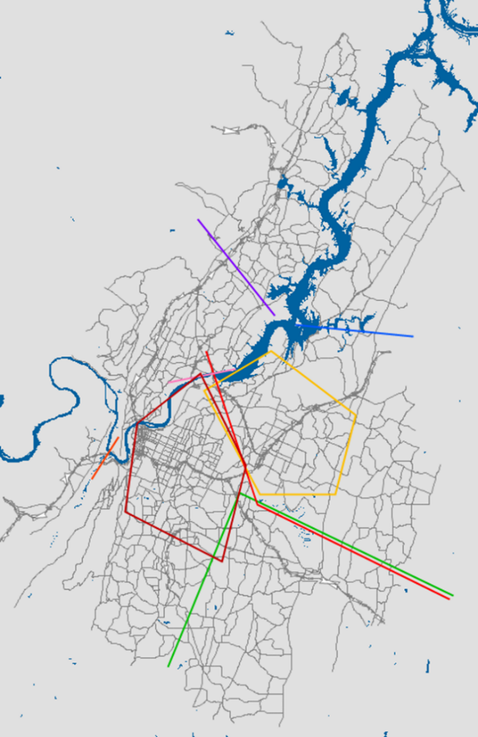
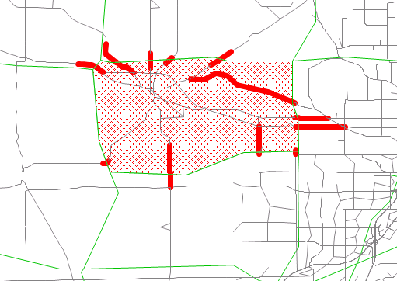
Iterative Screenline Fitting (ISF)
  Loop over screenlines
    Uses screenlines which partition region into two sets of zones – which partition the OD matrix into quadrants
    Off-diagonal quadrants receive factor based on ratio of weighted total counts to aggregated OD trips
      Weight based on number of screenlines each count is on, etc.
    Average new factors from this screenline with prior expansion factors

Slide 31
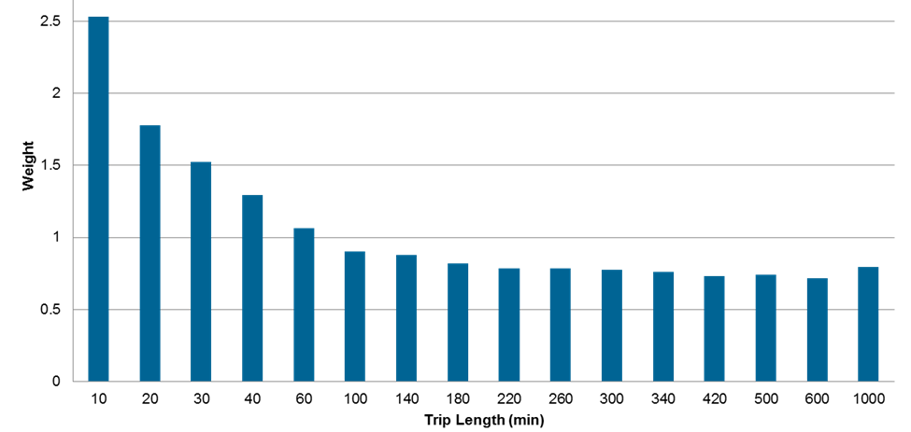
Non-Parametric Assignment-based Methods
  Direct ODME
    OD/cell-specific expansion factors (lots)
    Beware of over-fitting to counts!
      Many different ODME methods, important to use one that either minimizes error with respect to both counts and the original ODs or that minimizes error with respect to counts but only within certain constraints (e.g., -50% and +200%) – easier if ODME done after other methods
      Should measure difference / distance from original to output OD flows (e.g., MAE, MAPE), not just compare TLFDs
    Relatively easy to do but difficult to interpret / understand
  Indirect ODME
    Analyze results of ODME
    to create simpler set of
    expansion factors based
    on distance, regions, etc.

Slide 32
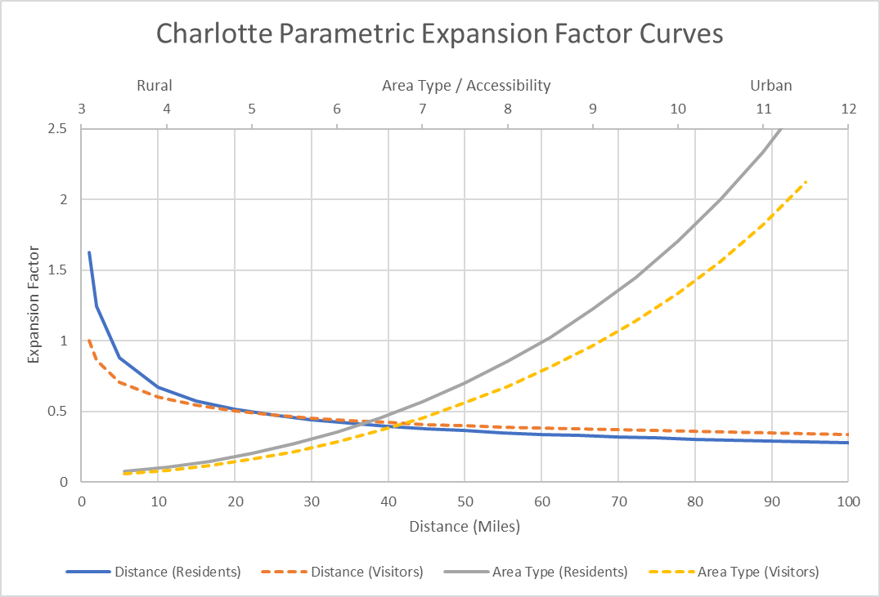
Parametric Scaling to Counts
  Uses assignment within a larger framework to estimate / calibrate parameters for an expansion factor function
  Terms often include
    Distance
    Area type or accessibility
  Estimation is NP-Hard
    Mixed success with
    genetic algorithm
    Mixed success with
    regression on ODME
    Manual calibration
    Intradistrict / intrazonal
    Adjacency

Slide 33
Disaggregate Trace Auditing

Slide 34
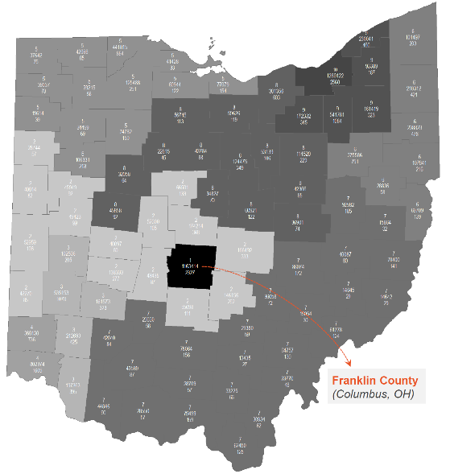
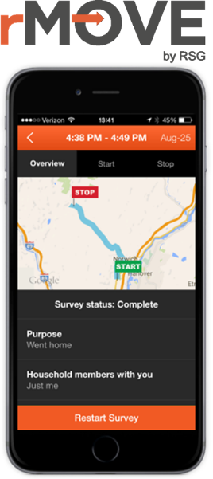
ODOT’s HH Survey with rMove
  On-going Household Survey for Ohio
    1/10th of Ohio collected every year for ten years
    About 75% collected by smartphone app, rMove
      Mostly using their own phones, but some using loaners
      These HH participate for 7 days
      Subset of smartphone group doing 6 month long distance survey
    About 25% collected online
      These HH participate for 1 day
 | Group 1 | Group 2 | Group 3 | Group 4
How many HH members age 16+ have smartphones? | All (100%) | Some | None (0%) | None (0%)
Given Choice for Participation | No | No* | Yes* | Yes
Study Participation Method | 100% use own smartphones | mix of owned and borrowed phones | 100% borrow smartphones | non-GPS (online diary)
Number of Days of Participation | 7 Days | 7 Days | 7 Days | 1 day
Total Count Recruited HHs | 4497 | 506 | 619 | 1739
Total Percent Recruited HHs | 61% | 7% | 8% | 24%
Total Count Completed HHs | 1751 | 176 | 359 | 792
Total Percent Completed HHs | 57% | 6% | 12% | 26%
* HHs recruited between March-May 2017 were not offered the option to borrow phones due to capacity limitations; HHs where some or no members owned smartphones were automatically assigned to the online diary during this time

Slide 35

Comparison of Cuebiq and rMove for
  TMIP interested in deep dive to understand fundamentals of new big data sets
    University of Washington looking at cellular and GPS data
    RSG looking at LBS data from Cuebiq
    ODOT agreed to allow use of rMove data
  First known disaggregate audit of passive data traces
    High level of confidence in rMove
      Trace verified by traveler, screened by AI,
      and if questionable reviewed by human analyst
    LBS exiting, but new and we want to understand it better
    Also, could help identify any remaining issues with rMove traces
    Also, first step toward new data fusion techniques

Slide 36
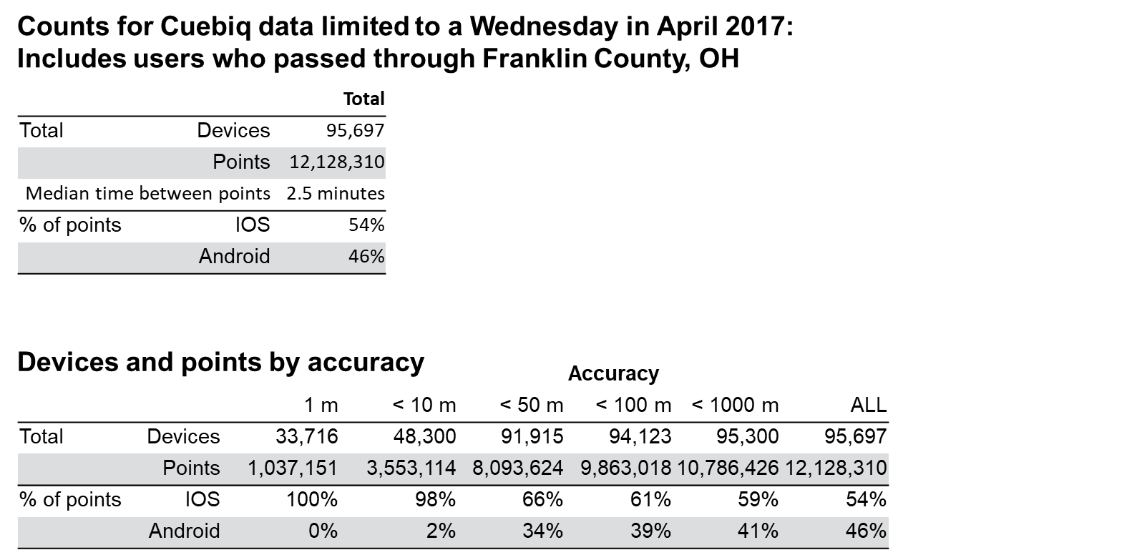
Summary of Cuebiq data for Franklin, Co.

Slide 37
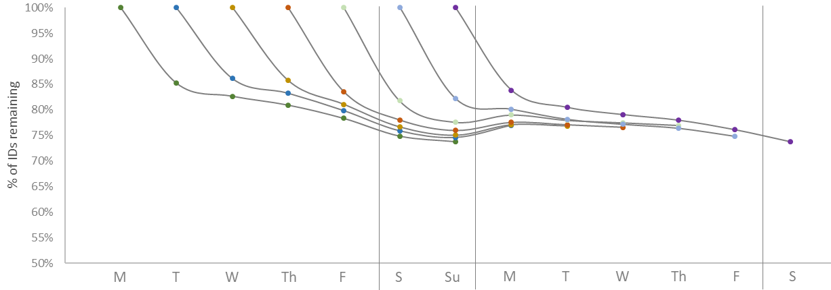
Cuebiq ID Persistence over Time
  ID persistence is quite strong
    70% to 80% of IDs are still active after a week
  Persistence is impacted by the weekend
    Phone and app usage may vary by day of week

Slide 38
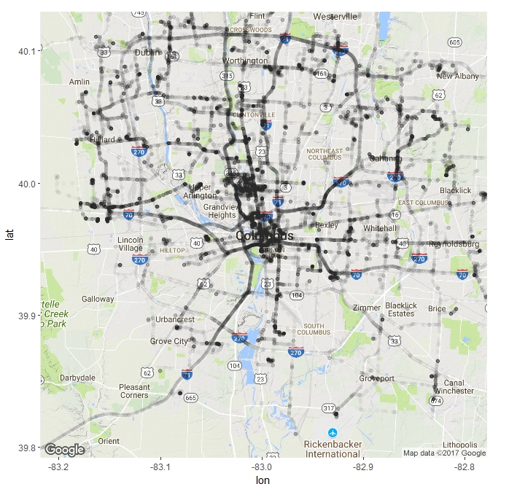
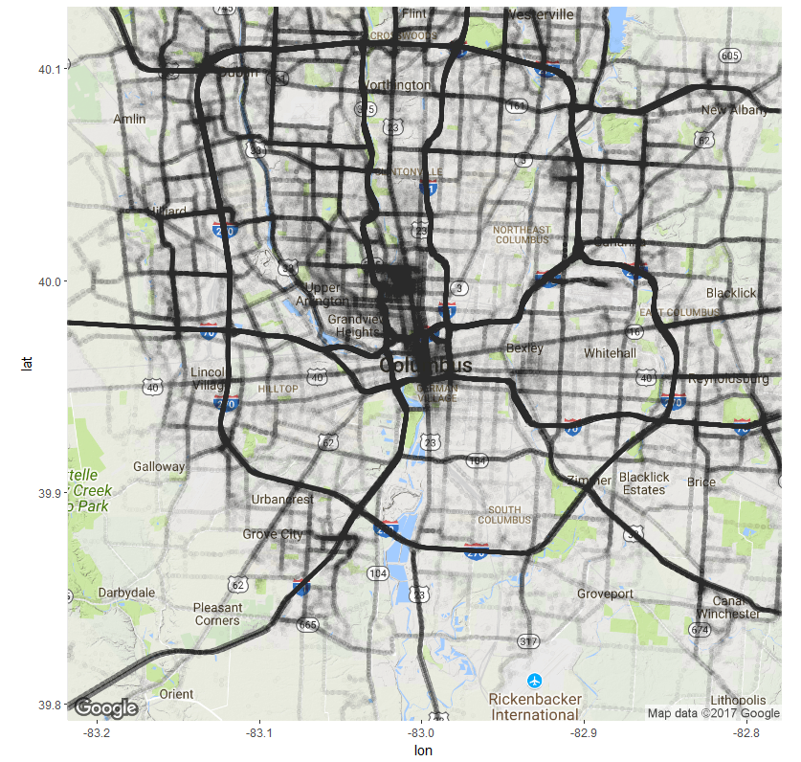
Mapping rMove vs. Cuebiq Locations
rMove – Wednesday in April
Cuebiq – Wednesday in April

Slide 39
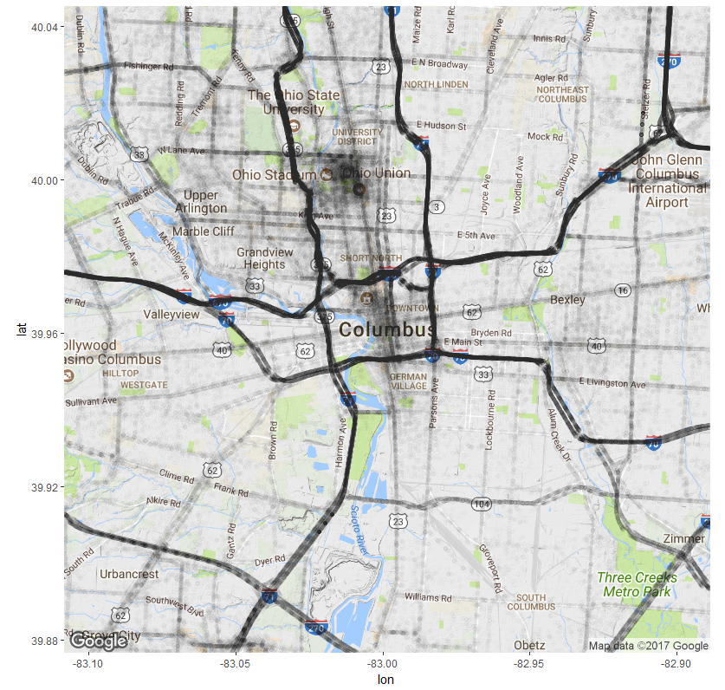
Cuebiq Locations – Detail

Slide 40
Aggregate Cuebiq to rMove Comparison
Summary of trip data from a Wednesday in April 2017, based on initial trip inference algorithm, compared to unweighted rMove data from the same day
 | Cuebiq inferred trips | rMove trips*
Number of Trips | 76,780 | 1,187
Number of Devices | 17,545 | 222
Trips per Device | 4.38 | 5.34
Median Distance | 3,462 m | 4,208 m
Mean Distance | 11,324 m | 10,354 m
*includes incomplete data not delivered to ODOT
What are the 20% missing from LBS?

Slide 41
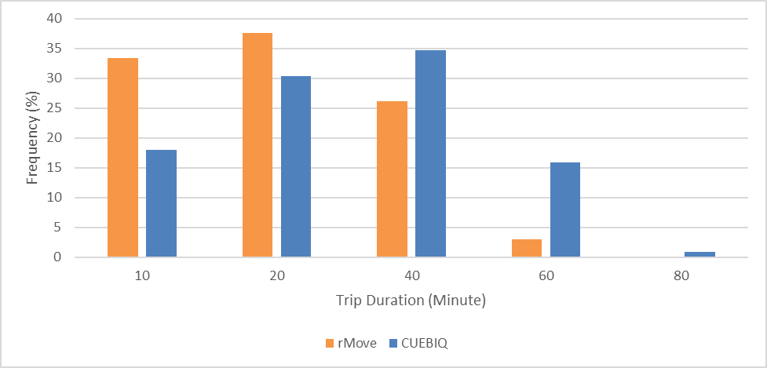

Trip Length Frequency
Comparison of Trip Duration shows longer trips make up a larger portion of the Cuebiq data than shorter trips

Slide 42
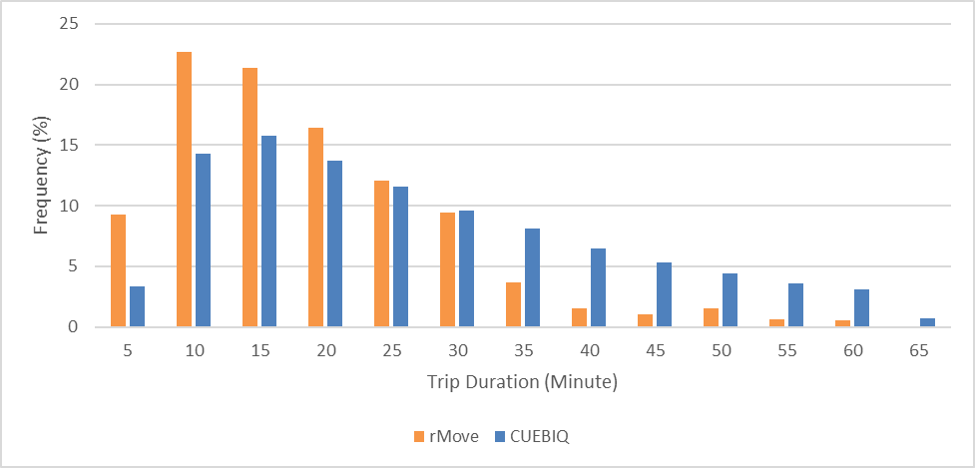
Trip Length Frequency (Detail)
Comparison of Trip Duration shows longer trips make up a larger portion of the Cuebiq data than shorter trips

Slide 43
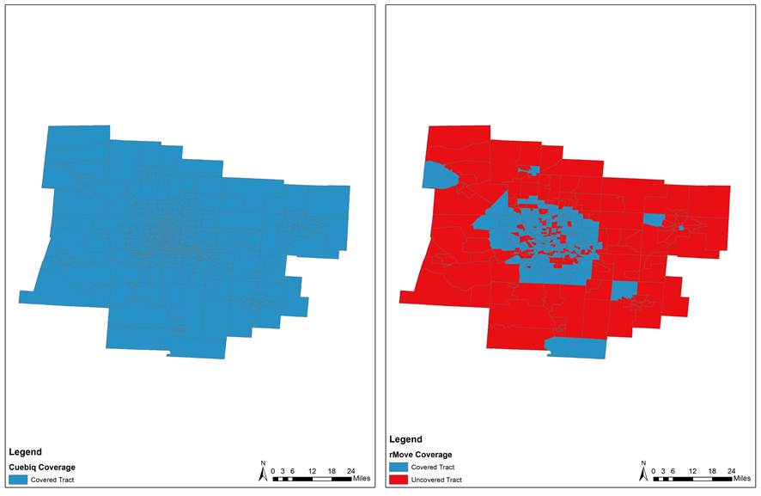
Geographic Coverage by Tract
From a single day, Cuebiq data has observations for every tract; rMove is missing a non-trivial portion, especially rural

Slide 44
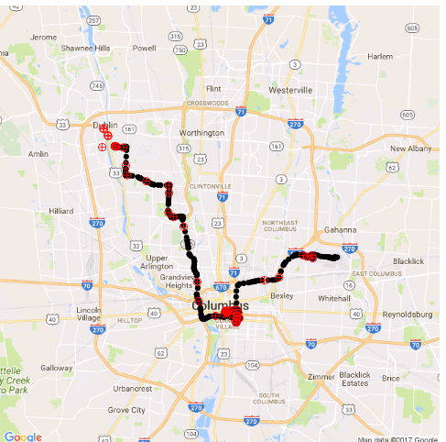
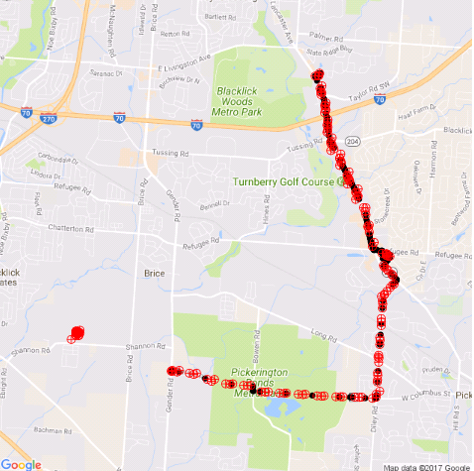
Maps of “Matched” User Locations
rMove locations
Cuebiq locations
  Locations on a Wednesday in April for “matched” users between ODOT study and Cuebiq Ohio data

Slide 45
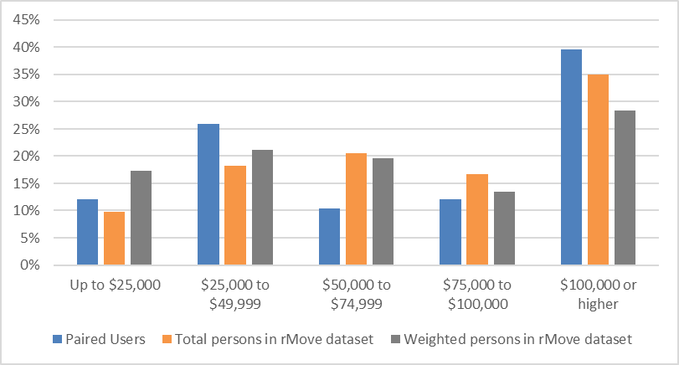
Income Bias
Matched Cuebiq users under-represent $50-100k households

Slide 46
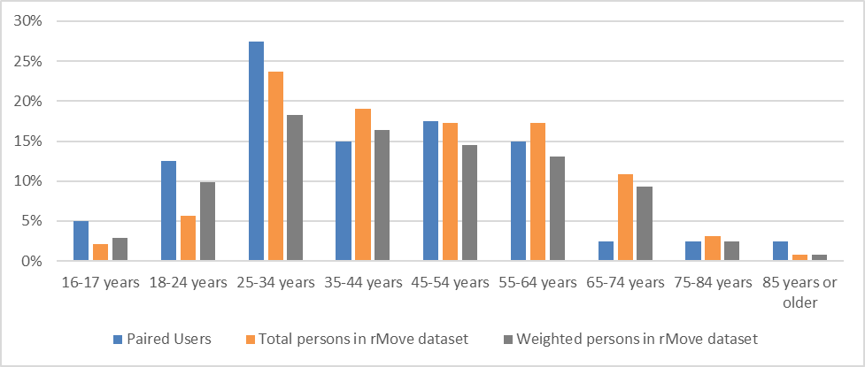
Age Bias
Both rMove and Cuebiq over-represent young people, but Cuebiq does much moreso

Slide 47
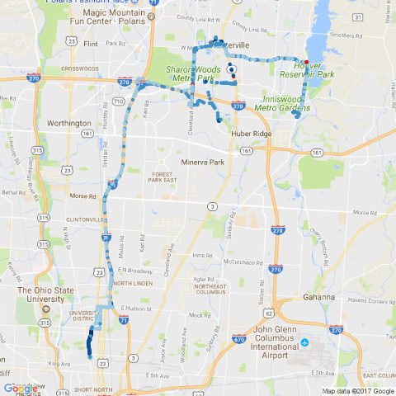
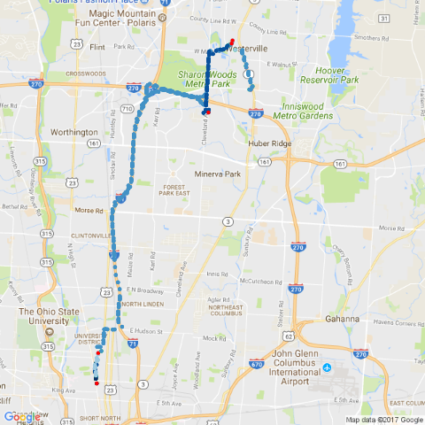
Missing Short Trips
An example of matched traces illustrating short trips detected in rMove but missing in Cuebiq
rMove
Cuebiq

Slide 48
Final Thoughts

Slide 49
Comparison of Expansion Methods
  Ensemble methods best for now
  Count-based expansion necessary for now
  Disaggregate methods hold promise

Slide 50
What’s Next?
  Data Driven Forecasting
    Pivoting, destination choice models with constants
    Better accuracy, analog to STOPS
  Accelerating Pace of Change
    Transformational changes
    Big data may provide key in more frequent updates
  Evolving Data & Methods
    New data sources entering the market
    Data fusion: surveys & big data

Slide 51
Contact
Vince Bernardin, Jr, PhD
DIRECTOR OF TRAVEL FORECASTING
Vince.Bernardin@rsginc.com
812.200.2351
www.rsginc.com
Steven Trevino
ANALYST
Steven.Trevino@rsginc.com
812.200.2352

